Slide 1
Chapter 5: CPU Scheduling
Bilkent University Department of Computer Engineering
CS342 Operating Systems
Last Update: Oct 16, 2018

Slide 2
Objectives and Outline
Outline
Basic Concepts
Scheduling Criteria
Scheduling Algorithms
Thread Scheduling
Multiple-Processor Scheduling
Operating Systems Examples
Algorithm Evaluation
Objective
To introduce CPU scheduling, which is the basis for multi-programmed (multi-tasking) operating systems
To describe various CPU-scheduling algorithms
To discuss evaluation criteria for selecting a CPU-scheduling algorithm for a particular system

Slide 3
Basic Concepts
Maximum CPU utilization obtained with multiprogramming
CPU–I/O Burst Cycle – Process execution consists of a cycle of CPU execution and I/O wait
CPU burst distribution

Slide 4
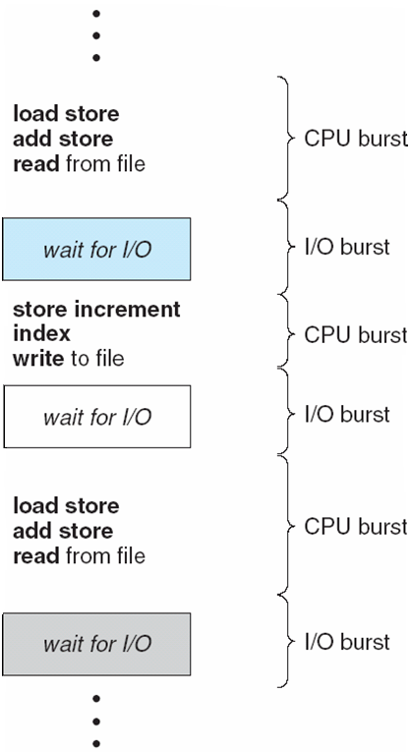
Alternating Sequence of CPU and I/O Bursts

Slide 5
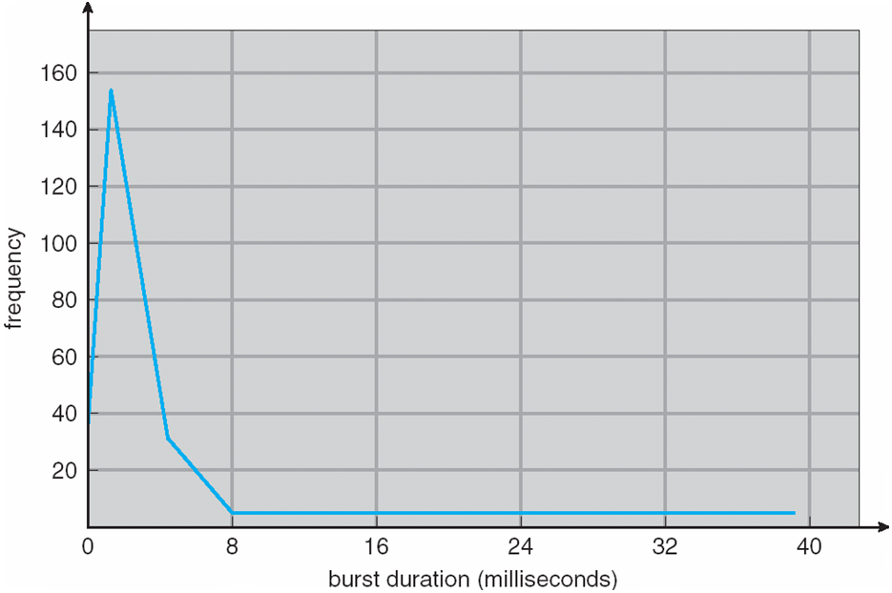
Histogram of CPU-burst Times

Slide 6
CPU Scheduler
Selects from among the processes in memory that are ready to execute, and allocates the CPU to one of them
CPU scheduling decisions may take place when a process:
1. Switches from running to waiting state
2. Switches from running to ready state (upon interrupts)
3. Switches from waiting to ready
4. Terminates
Scheduling under 1 and 4 is non-preemptive
All other scheduling is preemptive

Slide 7
Dispatcher
Dispatcher module gives control of the CPU to the process selected by the CPU scheduler; this involves:
switching context
switching to user mode
jumping to the proper location in the user program to restart that program
Dispatch latency – time it takes for the dispatcher to stop one process and start another running

Slide 8
Scheduling Criteria
CPU utilization – keep the CPU as busy as possible
Throughput – # of processes that complete their execution per time unit
Turnaround time – amount of time to execute a particular process
Waiting time – amount of time a process has been waiting in the ready queue
Response time – amount of time it takes from when a request was submitted until the first response is produced (for time-sharing environment)
Maximize CPU utilization
Maximize throughput
Minimize turnaround time
Minimize waiting time
Minimize response time
ready
running
waiting

Slide 9
Scheduling Algorithms

Slide 10
First-Come, First-Served (FCFS) Scheduling
Process Burst Time (ms)
P₁ 24
P₂ 3
P₃ 3
Suppose that the processes arrive in the order: P₁ , P₂ , P₃ The Gantt Chart for the schedule is:
Waiting time for P₁ = 0; P₂ = 24; P₃ = 27
Average waiting time: (0 + 24 + 27)/3 = 17 ms
P₁
P₂
P₃
0
24
27
30

Slide 11
FCFS Scheduling (Cont)
Suppose that the processes arrive in the order
P₂ , P₃ , P₁
The Gantt chart for the schedule is:
Waiting time for P₁ = 6; P₂ = 0; P₃ = 3
Average waiting time: (6 + 0 + 3)/3 = 3 ms
Much better than previous case
Convoy effect: short process behind long process
P₂
P₃
P₁
0
3
6
30

Slide 12
Shortest-Job-First (SJF) Scheduling
Associate with each process the length of its next CPU burst. Use these lengths to schedule the process with the shortest time
SJF is optimal – gives minimum average waiting time for a given set of processes
The difficulty is knowing the length of the next CPU request

Slide 13
Example of SJF
Process Arrival Time Burst Time
P₁ 0.0 6
P₂ 0.0 8
P₃ 0.0 7
P₄ 0.0 3
SJF scheduling chart
Average waiting time = (3 + 16 + 9 + 0) / 4 = 7 ms
P₄
P₁
P₃
P₂
0
3
9
16
24

Slide 14
Determining Length of Next CPU Burst
Can only estimate the length
Can be done by using the length of previous CPU bursts
using exponential averaging of previous burst lengths

Slide 15
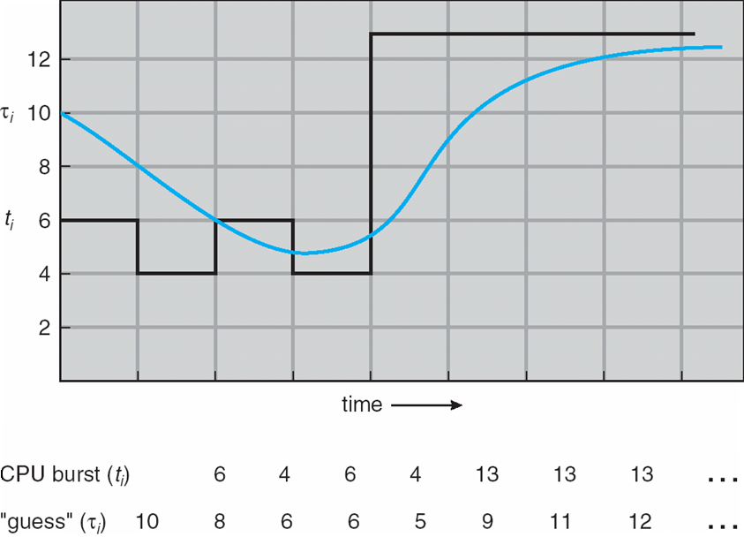
Prediction of the Length of the Next CPU Burst

Slide 16
Estimating the Length of next CPU Burst: Exponential Averaging
Let τ_{n} denote the estimate for n^{th} CPU burst.
This is estimate; actual may be different.
Let t_{n} denotes the length of the n^{th} CPU burst.
This is the actual length (known after burst executes)
Let τ_{n+1} denote the estimated value for the next CPU brst
Assume the first CPU burst is Burst0 and its length is t₀.
Define α to be: 0 <= α <= 1
Define τ_{n+1} as: τ_{n+1} = α t_{n} + (1 - α ) τ_{n}

Slide 17
Exponential Averaging
We have CPU bursts as: Burst(0), Burst(1), Burst(2)….Burst(n), Burst(n+1). The actual lengths of these bursts are denoted by: t₀, t₁, t₂, t₃, …., t_{n}, t_{n+1}. Let τ₀ be initial estimate (i.e., estimate for Burst(0)) and let it be a constant value like 10 ms. Then
τ₁ = α t₀ + (1 - α ) τ₀
If we expand the formula, we get:
τ_{n+1} = α t_{n} + (1 - α)α t_{n-1} + …. + (1 - α )^{j} α t_{n-j} + …..
+ (1 - α )^{n} α t₀ + (1 - α )^{n +1} τ₀
Since both α and (1 - α) are less than or equal to 1, each successive term has less weight than its predecessor

Slide 18
Exponential Averaging
If α =0
τ_{n+1} = τ_{n}
Recent history does not count
If α =1
τ_{n+1} = α t_{n}
Only the actual last CPU burst counts
Usually we have α between 0 and 1, for example 0.5

Slide 19
Example
τ₀ = 10 ms
Measured CPU bursts: t₀ = 8ms, t₁=16ms, t₂=20ms, t₃=10ms
Assume α = ½
τ₁ = ½ x 8 + ½ x 10 = 9
τ₂ = ½ x 16 + ½ x 9 = 12.5
τ₃ = ½ x 20 + ½ x 12.5 = 16.25
τ₄ = ½ x 10 + ½ x 16.25 = 13.125
The next CPU burst is estimated to be 13.125 ms. After burst is executed, it is measured as t₄.

Slide 20
Shortest Remaining Job First (SRJF)
Preemptive version of SJF
While a job A is running, if a new job B comes whose length is shorter than the remaining time of job A, then B preempts A and B is started to run.

Slide 21
Shortest Remaining Job First (SRJF)
Process Arrival Time Burst Time
P₁ 0.0 8
P₂ 1.0 4
P₃ 2.0 9
P₄ 3.0 5
SRJF scheduling chart
Average waiting time = (9 + 0 + 2 + 15) / 4 = 6.5 ms
P₁
P₂
P₄
P₁
P₃
0
1
5
10
17
26

Slide 22
Example
Assume we have the following processes. Find out the finish time, waiting time and turnaround time of each process for the following scheduling algorithms: FCFS, SJF, SRJF.
Process | Arv time | CPU Burst
A | 0 | 30
B | 5 | 20
C | 10 | 12
D | 15 | 10

Slide 23
Example
FCFS: Processes will run in the order they arrive. The following is the finish,
turnaround, waiting time of each process.
 | Arv | Burst | Finish | Turnaround | Waiting
A | 0 | 30 | 30 | 30 | 0
B | 5 | 20 | 50 | 45 | 25
C | 10 | 12 | 62 | 52 | 40
D | 15 | 10 | 72 | 57 | 47

Slide 24
Example
SJF: running order will be: A(30) D(10) C(12) B(20)
 | Arv | Burst | Finish | Turnaround | Waiting
A | 0 | 30 | 30 | 30 | 0
B | 5 | 20 | 72 | 67 | 47
C | 10 | 12 | 52 | 42 | 30
D | 15 | 10 | 40 | 25 | 15

Slide 25
Example
SRJF: running order will be: A(5) B(5) C(12) D(10) B(15) A(25)
 | Arv | Burst | Finish | Turnaround | Waiting
A | 0 | 30 | 72 | 72 | 42
B | 5 | 20 | 47 | 42 | 22
C | 10 | 12 | 22 | 12 | 0
D | 15 | 10 | 32 | 17 | 7

Slide 26
Priority Scheduling
A priority number (integer) is associated with each process
The CPU is allocated to the process with the highest priority (smallest integer ≡ highest priority)
Preemptive (higher priority process preempts the running one)
Non-preemptive
SJF is a priority scheduling (non-preemptive) where priority is the predicted next CPU burst time.
SRJF is preemptive
Problem ≡ Starvation – low priority processes may never execute
Solution ≡ Aging – as time progresses increase the priority of the process

Slide 27
Example
 | Arv | CPU burst | Priority
A | 0 | 20 | 3
B | 5 | 15 | 2
C | 10 | 20 | 0
D | 25 | 15 | 1
E | 30 | 20 | 1
Nonpreemptive priority scheduling: AAAACCCCDDDEEEEBBB assuming each letter is 5 time units
Finish times: A: 20, B: 90, C: 40, D: 55, E: 75
Preemptive priority scheduling:
ABCCCCDDDEEEEBBAAA
Finish times: A: 90, B: 75, C:30, D: 45, E: 65

Slide 28
Round Robin (RR)
Each process gets a small unit of CPU time (time quantum), usually 10-100 milliseconds. After this time has elapsed, the process is preempted and added to the end of the ready queue.
If there are n processes in the ready queue and the time quantum is q, then each process gets 1/n of the CPU time in chunks of at most q time units at once.
No process waits more than (n-1)q time units.
Performance
q large ⇒ FIFO
q small ⇒ good CPU sharing
q must be large with respect to context switch time, otherwise overhead is too high

Slide 29
Example of RR with Time Quantum = 4
Process Burst Time
P₁ 24
P₂ 3
P₃ 3
The Gantt chart is:
Typically, higher average turnaround than SJF, but better response time
P₁
P₂
P₃
P₁
P₁
P₁
P₁
P₁
0
4
7
10
14
18
22
26
30

Slide 30
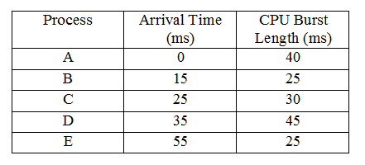
Example
Finish time of each process?
a) Round Robin q=30
b) Round Robin q=10

Slide 31
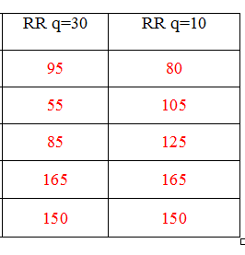
Example
Solution
A
B
C
D
E

Slide 32
RR vs FCFS
Round Robin is good for fast response, not for low turnaround time.
Assume 3 jobs all arrived at time 0. Each has a CPU burst = 10
C
C
C
B
B
B
A
A
A
RR q=5
FCFS
A: 20 B: 25
C: 30
A: 10 B: 20
C: 30
Turnaround times
Turnaround times

Slide 33
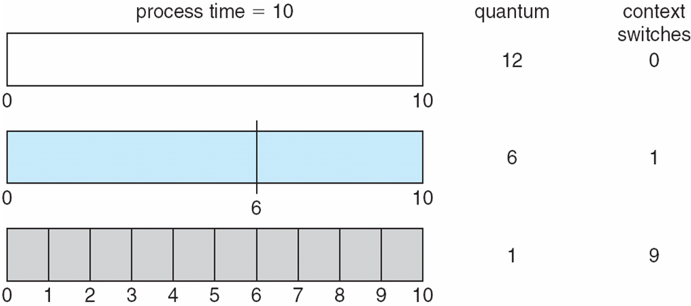
Time Quantum and Context Switch Time

Slide 34
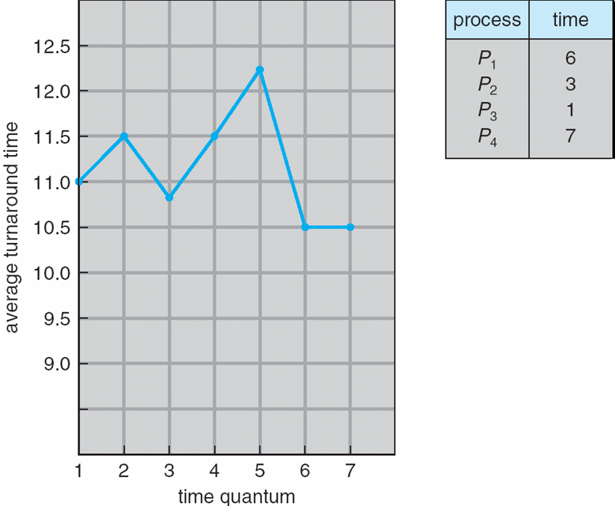
Turnaround Time Varies With The Time Quantum

Slide 35
Multilevel Queue
Ready queue is partitioned into separate (multiple) queues:.
For example:
Two queues
foreground (interactive) and background (batch)
Each queue has its own scheduling algorithm
foreground – RR
background – FCFS
Scheduling must be done between the queues as well
Fixed (strict) priority scheduling; (i.e., serve all from foreground then from background). Possibility of starvation.
Time slicing – each queue gets a certain amount of CPU time which it can schedule amongst its processes; i.e., 80% to foreground in RR; 20% to background in FCFS

Slide 36
Multilevel Queue Scheduling

Slide 37
Multilevel Feedback Queue
A process can move between the various queues; aging can be implemented this way
A specific Multilevel-Feedback-Queue scheduler is defined by the following parameters:
number of queues
scheduling algorithms for each queue
method used to determine when to upgrade a process
method used to determine when to demote a process
method used to determine which queue a process will enter when that process needs service

Slide 38
Example of Multilevel Feedback Queue
Three queues:
Q₀ – RR with time quantum 8 milliseconds
Q₁ – RR time quantum 16 milliseconds
Q₂ – FCFS
Scheduling
A new job enters queue Q₀ which is served RR (q=8). When it gains CPU, job receives 8 milliseconds. If it does not finish in 8 milliseconds, job is moved to queue Q₁.
At Q₁ job is again served RR and receives 16 additional milliseconds. If it still does not complete, it is preempted and moved to queue Q₂.
At Q₂, jobs are served with FCFS

Slide 39
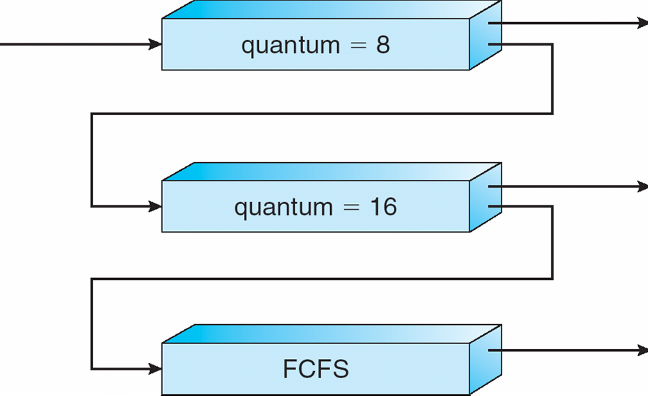
Multilevel Feedback Queues

Slide 40
Thread Scheduling

Slide 41
Thread Scheduling
Distinction between user-level and kernel-level threads
In many-to-one and many-to-many models, user-level thread library schedules user-level threads to run on an LWP (virtual processor)
This is known as process-contention scope (PCS), since scheduling competition is happening within the process
In one-to-one model, kernel schedules a thread onto available CPU.
This is known as system-contention scope (SCS) – since scheduling competition is happening with the system.

Slide 42
Pthread Scheduling
API allows specifying either PCS or SCS during thread creation
PTHREAD SCOPE PROCESS schedules threads using PCS scheduling
PTHREAD SCOPE SYSTEM schedules threads using SCS scheduling.

Slide 43
Pthread Scheduling API
#include <pthread.h>
#include <stdio.h>
#define NUM THREADS 5
int main(int argc, char *argv[])
{
int i;
pthread t tid[NUM THREADS];
pthread attr t attr;
/* get the default attributes */
pthread attr init(&attr);
/* set the scheduling algorithm to PROCESS or SYSTEM */
pthread attr setscope(&attr, PTHREAD_SCOPE_SYSTEM);
/* set the scheduling policy - FIFO, RT, or OTHER */
pthread attr setschedpolicy(&attr, SCHED_OTHER);
/* create the threads */
for (i = 0; i < NUM THREADS; i++)
pthread create(&tid[i],&attr,runner,NULL);

Slide 44
Pthread Scheduling API
/* now join on each thread */
for (i = 0; i < NUM THREADS; i++)
pthread join(tid[i], NULL);
}
/* Each thread will begin control in this function */
void *runner(void *param)
{
printf("I am a thread\n");
pthread exit(0);
}

Slide 45
Multiprocessor Scheduling

Slide 46
Multiple-Processor Scheduling
CPU scheduling more complex when multiple CPUs are available
Homogeneous processors within a multiprocessor
Asymmetric multiprocessing – only one processor accesses the system data structures, alleviating the need for data sharing
Symmetric multiprocessing (SMP) – each processor is self-scheduling, all processes in common ready queue, or each has its own private queue of ready processes
Processor affinity – process has affinity for processor on which it is currently running
soft affinity
hard affinity

Slide 47
Multiple-Processor Scheduling SMP
CPU
CPU
CPU
Cache
Cache
Cache
Kernel
P1
P2
P3
P10
sch
…
Main Memory

Slide 48
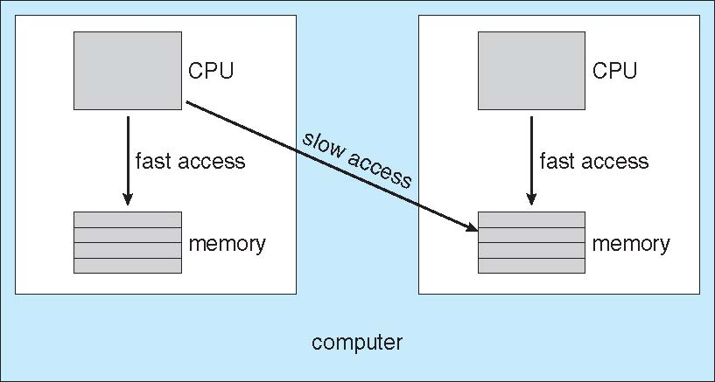
NUMA and CPU Scheduling

Slide 49
Multicore Processors
Recent trend to place multiple processor cores (CPUs) on same physical chip (die)
Faster and consumes less power
Multiple threads per core also growing (hardware threading)
Takes advantage of memory stall to make progress on another thread while memory retrieve is happening

Slide 50
Multithreaded Multicore System

Slide 51
Real-Time CPU Scheduling

Slide 52
Real time systems
Real-time processes (tasks) running in a system
HaSoft real time system
Commonly, RT systems are event-driven systems
An event occurs: need to respond (sun a task) as quickly as possible
Minimizing latency is important
Latency
Interrupt latency : time from interrupt till start of ISR
Dispatch latency: time between task becomes runnable till task gets running (includes the stopping of a current running process)

Slide 53
Latency

Slide 54
Scheduling
Priority based scheduling
Priority based algorithm used
Preemption may be provided as well
Soft real time systems apply this.
No hard guarantees
Hard real time guarantees
There are deadlines for processes (tasks) to start executing
Process may be periodic or not
Admission control required

Slide 55
Hard guarantees
Periodic tasks:
period (p) and rate (1/p),
cpu time (t),
deadline (d); We must have: 0 <= t <= d <= p
Example scheduling: Rate monolithic scheduling
Non periodic tasks:
Example scheduling: Earliest deadline first (EDF)

Slide 56
Rate monolithic scheduling
Static priority used
Priority inversely proportional with period.
Preemptive: high priority task preempts low priority task
CPU burst time (processing time) equal in all periods.
CPU burst must be executed before the next period.
Implicit Deadline = beginning of next period.
Can underutilize CPU.
Is optimal for static priority case (i.e., if we can not assign priorities dynamically)

Slide 57
Rate monolithic scheduling
Example: P1: cputime:20; period 50 P2: cputime:35; period100
20/50 + 35/100 = 75 / 100 less than 1
Example: P1: cputime:25; period 50 P2: cputime:35; period 80
25/50 + 35/80 = 375/400 less than 1
deadline missed

Slide 58
Earliest Deadline First (EDF)
Dynamically assigns priorities depending on the Deadlines.
When a process becomes runnable (ready), it announces its deadline.
The process that has the Earliest Deadline is scheduled.
Tasks do not need to be periodic
CPU bursts may be different
Theoretically optimal: can meet deadlines and can utilize 100%
Example: Two periodic processes (tasks): P1: cputime: 25; period 50 P2: cputime 35; period: 80

Slide 59
Proportional Share Scheduling
Allocate T shares among all applications (processes)
If an application has N shares, it can get N/T of CPU time.
System ensures that each process gets CPU time proportional to its shares.
Admission control policy required.

Slide 60
Examples from Operating Systems

Slide 61
Operating System Examples
Solaris scheduling
Windows XP scheduling
Linux scheduling

Slide 62
Solaris Dispatch Table

Slide 63
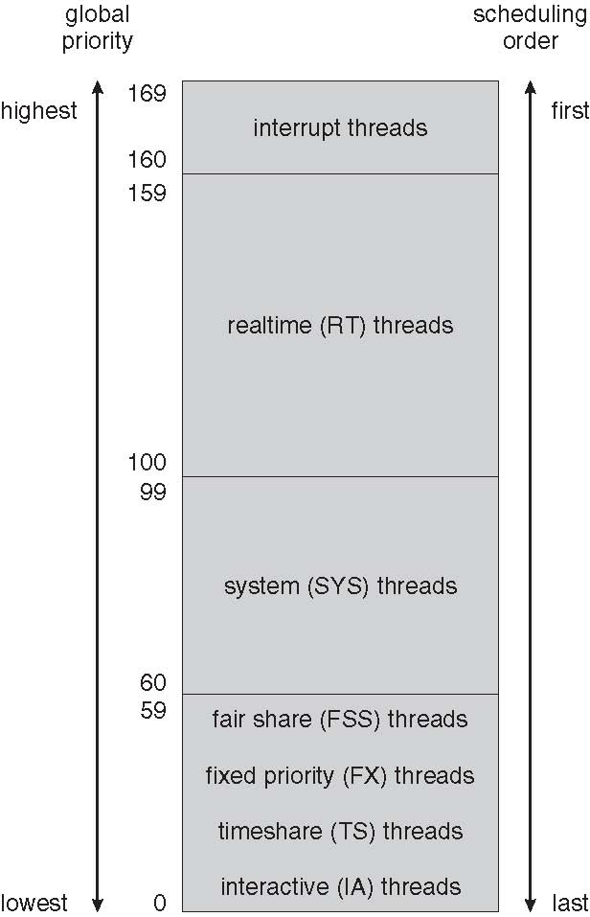
Solaris Scheduling

Slide 64
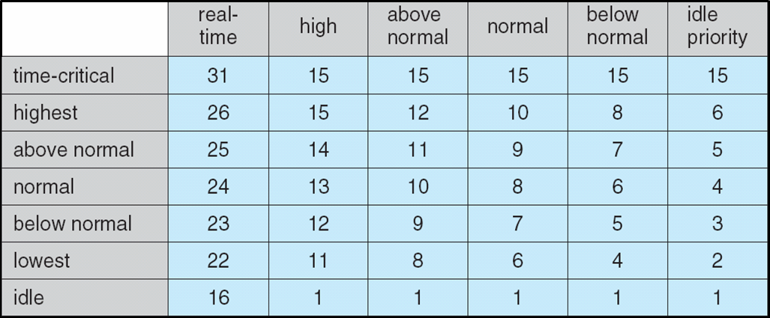
Windows XP Priorities

Slide 65
Linux Scheduling - CFS
Earlier O(1) scheduling; now, CFS scheduling is used
CFS: Completely Fair Scheduling
Uses scheduling classes. Two classes at the moment.
Each class uses a fixed priority range.
1) time-sharing (default scheduling) class (100-140) 2) real-time class (0-99)
In time sharing:
user can specify a nice value (priority value) between -20 and +19.
Assigns a proportion of CPU time based on nice value indirectly.
Lower nice value -> higher CPU time given at the end
Targeted latency: a time interval each process must run once
Interval allocated proportionally among processes

Slide 66
Linux Scheduling
For time sharing class, CFS does not assign priorities directly.
There are no separate runqueues.
Keep track how long each process has run as virtual runtime.
Virtual runtime is advanced more for a lower priority (higher nice value) process, less for a higher priority process.
Hence decay for low priority is higher.
Example: 200 ms actual run time will be more for low priority process, less for high priority process, same for nice value 0.
Select the process that has the lowest virtual runtime.

Slide 67
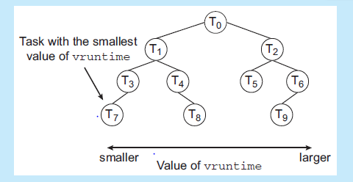
Linux Scheduling
Keep processes in runnable state in a red-black tree (a balanced tree) with respect to their virtual runtimes.
The process on the left lower side is the one to run next.
Selection: O(1);
Insertion of a process into tree: O(logN)

Slide 68
Algorithm Evaluation

Slide 69
Algorithm Evaluation
Deterministic modeling – takes a particular predetermined workload and defines the performance of each algorithm for that workload
One form of analytic evaluation
Valid for a particular scenario and input.
Queuing models
Simulation
Implementation

Slide 70
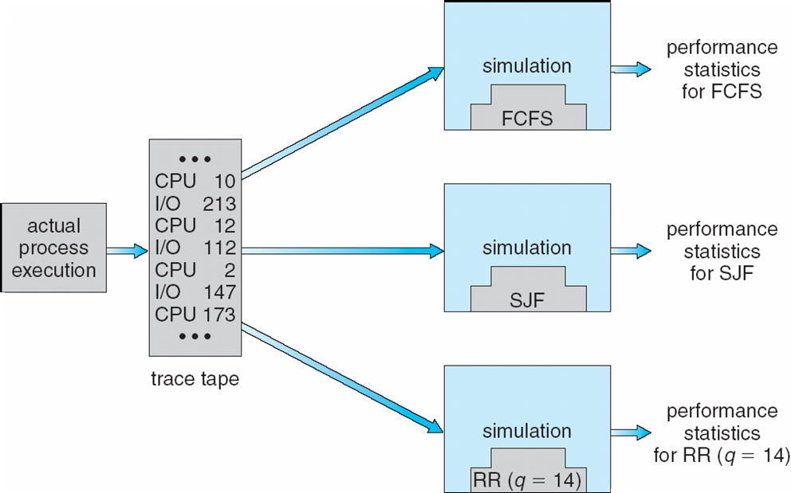
Evaluation of CPU schedulers by Simulation

Slide 71
Queuing Models
Average throughput, utilization, and waiting time can be computing by using queuing models for a system
In this case, one or more CPUs and one or more ready queues make the system.
Arrivals of tasks modeled by a distribution (inter-arrival times)
Exponential distribution is a good approximation for stochastic arrivals (as opposed to deterministic arrivals)
Service times (cpu times) modeled by a distribution
Exponential distribution is a good approximation for CPU times required (i.e., services times).
A branch of mathematics called queuing networks analysis uses such modes to analyze systems for waiting time, throughput, etc.

Slide 72
Queuing Models
Little’s formula relates the arrival rate, waiting time, and queue length in a system that may have random arrivals and random service (CPU) times.
Little’s formula: N = W ∗ λ
N: number of tasks in the queue including the one in the cpu
W: the average waiting in the system for a task (time spend in queue + time spent for execution). [i.e., time spend in the system]
λ: arrival rate (number of tasks arriving per second)
Assumes a stable system (service rate > arrival rate)
Valid for any arrival and service time distribution
Work conserving system (if there is a task in ready queue, cpu does not stay idle)

Slide 73
Example: Assume arrival rate is 30 tasks/sec. What is the average queue length (including the task executing), if on the average a task waits 200 ms in the system (including the cpu execution)?
Answer:
N = W ∗ λ
Therefore, N = 200 ms * 30 tasks/sec = 6. That means there are 6 tasks in the system on the average, that are waiting in the queue or running.
Note that: if arrivals and service times are deterministic, no queuing and therefore no waiting in the queue will happen. Waiting in the queue happens due to random (stochastic) arrivals, i.e., bursty arrivals.

Slide 74
References
The slides here are adapted/modified from the textbook and its slides: Operating System Concepts, Silberschatz et al., 9th edition, Wiley.
Operating System Concepts, 9th edition, Silberschatz et al. Wiley.
Modern Operating Systems, Andrew S. Tanenbaum, 3rd edition, 2009

